Slide 1

Update: Automating Processing and Distribution of MODIS and AVHRR Satellite Image Products for Monitoring Landscape Processes in Alaska National Parks
Parker Martyn
Inventory Coordinator
December 6, 2010
Notes:
Poster created April 2010.

Slide 2
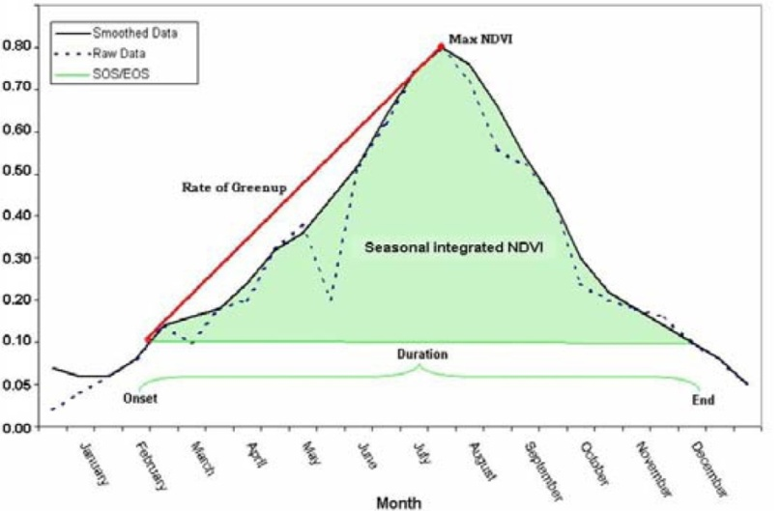
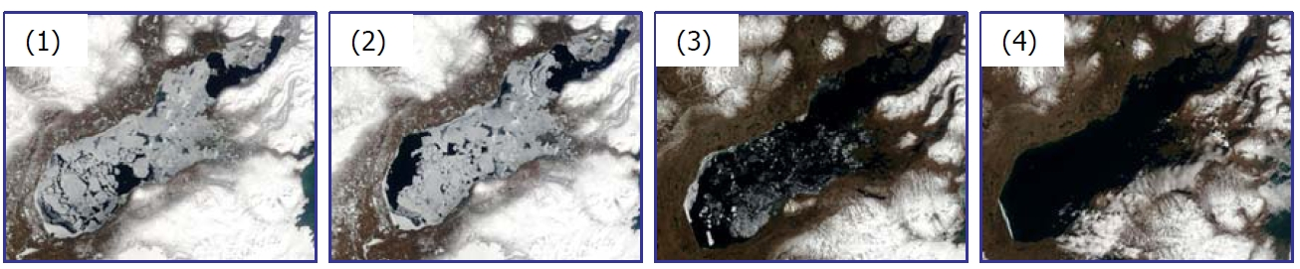
Objectives
The primary objectives for monitoring are:
Onset and freeze-up of ice on large freshwater bodies
Pattern and timing of snow cover
Timing of green-up and senescence in vegetation (i.e., vegetative productivity).
Monitoring requires:
Temporal window of days to weeks
Ability to track processes at a large spatial scale
Large size and wilderness character of parklands in Alaska limits ground-based measurements.
Satellite sensor data provides measurement for:
Freeze-up & Snow Cover Snow & Ice Satellite Data
Vegetative Productivity NDVI
Green vegetation reflects strongly in the NIR band and absorbs strongly in the R band.
NDVI = (NIR – R)/(NIR + R)
Values in the range of -1.0 to 1.0
Positive values indicate green vegetation
Negative values indicate nonvegetated surface features such
as water, barren, ice, snow, or clouds
Satellite image time series of lake ice breakup on Lake Iliamna, April 15 – May 10, 2005
Notes:
Poster created April 2010.

Slide 3
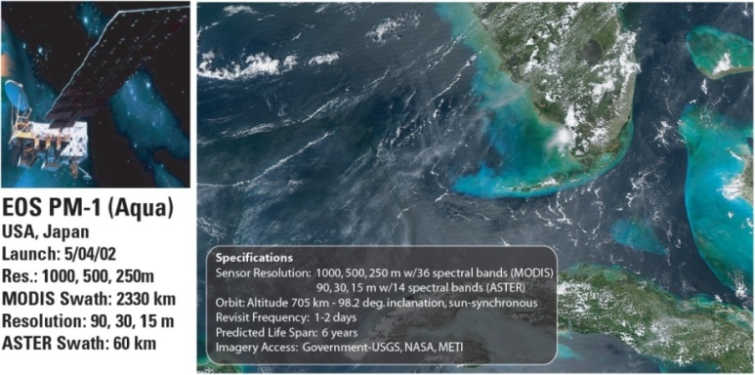
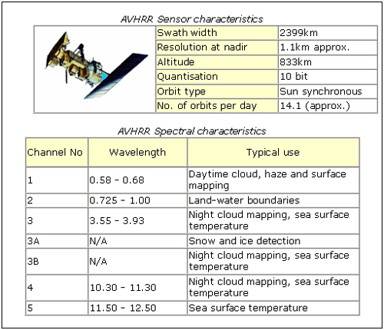
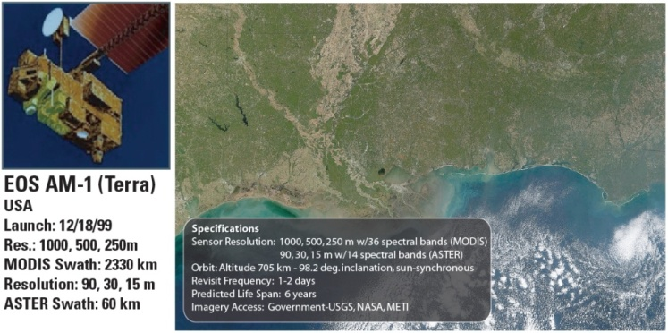
AVHRR & MODIS Sensors
Advanced Very High Resolution Radiometer (AVHRR)
Moderate Resolution Imaging Spectroradiometer (MODIS)
Uses:
Uses:
Volcano monitoring
Weather research and operations
Sea ice studies
Forest fire spread and smoke monitoring
Large area vegetation mapping and vigor determination
Sea surface temperature calculation
Ocean turbidity and surface circulation
Land/cloud boundaries
Land/cloud properties
Ocean color
Atmospheric water vapor
Surface/cloud temperature
Atmospheric temperature
Cirrus clouds/water vapor
Ozone
Surface/cloud temperature
Cloud top altitude
Notes:
Poster created April 2010.

Slide 4
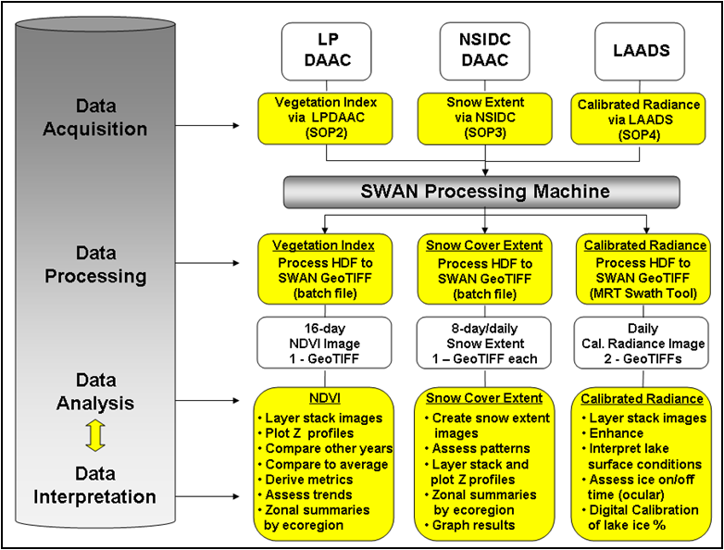
SWAN NDVI/Snow Process Flow (Original)
Notes:
Poster created April 2010.

Slide 5
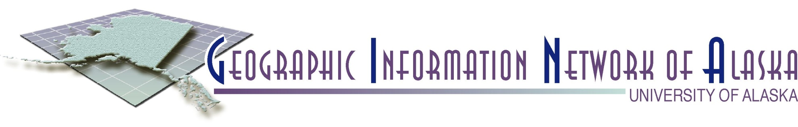













GINA
GINA is…
Real-time Satellite Imagery and Data:
Received by GINA
Received in partnership with others
(e.g. NOAA Fairbanks ground station)
Geospatial Data:
SDMI – Alaska Mapped Clearinghouse
Raster (images, grids)
Vector (point, line, polygon)
Metadata
Software:
SwathViewer
3.6-meter Antenna
SeaSpace X-band Ground Station
MODIS on NASA Terra and Aqua
1.2-meter Antenna
SeaSpace L-band Ground Station
AVHRR on NOAA polar orbiters
Notes:
Poster created April 2010.

Slide 6
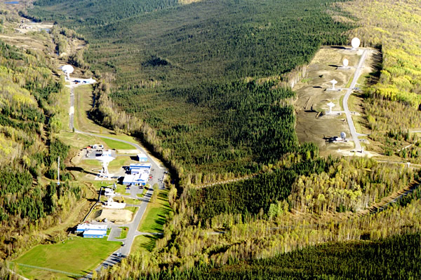
GINA is partner with NOAA/NESDIS-FCDAS Gilmore Creek, Alaska
Notes:
Poster created April 2010.

Slide 7
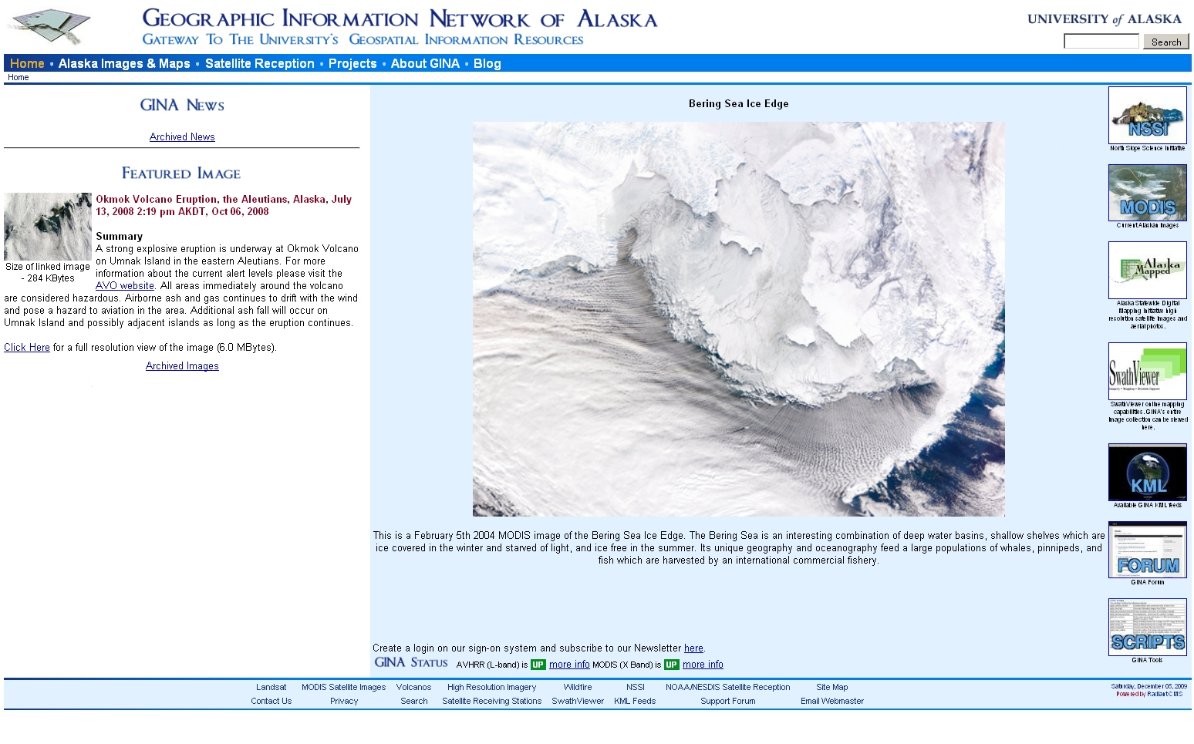
GINA – Geospatial Data Portal & Tools
Notes:
Poster created April 2010.

Slide 8
SWAN NDVI/Snow Process Flow (with GINA)
LP DAAC
NSIDCDAAC
GINA GSFC
Data Acquisition
DAACs
Vegetation Index via LPDAAC
Snow Extent
via NSIDC
True Color Imagery via GINA
Vegetation Index
Processed to GeoTIFF &
WCS / WMS
Snow Cover Extent
Processed to GeoTIFF &
WCS / WMS
True Color Imagery Processed to GeoTIFF &
WCS / WMS
Data Processing
16-day
NDVI Image
(Statewide)
8-day/daily
Snow Extent
(Statewide)
Daily
True Color Imagery
(Statewide)
GINA
Data Analysis
NDVI
Layer stack images
Plot Z profiles
Derive metrics
Zonal summaries by
ecoregion
Snow Cover Extent
Create snow extent
images
Layer stack and plot
Z profiles
Zonal summaries by
ecoregion
Graph results
True Color Imagery
Layer stack images
Enhance
True Color Imagery
Interpret lake
surface conditions
Assess ice on/off
time (ocular)
Digital Calibration
of lake ice %
Data Interpretation
NDVI
Compare other years
Compare to average
Assess trends
Snow Cover Extent
Assess patterns
SWAN
Notes:
Poster created April 2010.

Slide 9
Work Year #1: 2009 – 2010
Obtain historical data archives for AVHRR and MODIS NDVI / SNOW data from NSIDC, LP-DAAC, and EROS
Build WMS/WCS distribution mechanism for AVHRR/MODIS (NDVI / SNOW )
Automate data ingest, production, and distribution of MODIS and AVHRR data products
Serve MODIS & AVHRR NDVI / SNOW Data to NPS
Work with NPS personnel to begin using data, and begin developing methods to generate metrics
Build the NDVI archive…
Serve it out…
Notes:
Poster created April 2010.

Slide 10
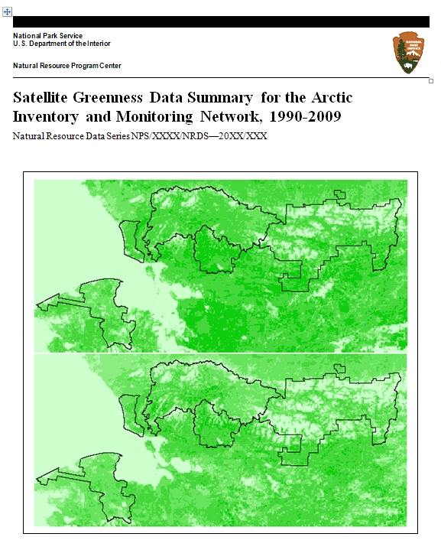
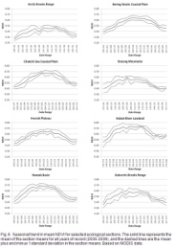
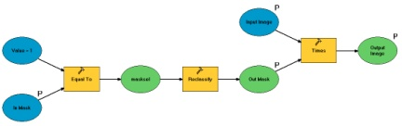
ARCN NDVI Process Flow
LP DAAC
Data Acquisition
DAACs
Vegetation Index via LPDAAC
Vegetation Index
Processed to GeoTIFF &
WCS / WMS
Data Processing
16-day
NDVI Image
(Statewide)
GINA
Data Analysis
NDVI
Layer Stack Images
Derive Metrics
Zonal Summaries by
ecoregion
Compare other
years
Compare to average
Assess trends
Data Interpretation
ARCN
Not the actual model used
Notes:
Poster created April 2010.

Slide 11
Work Year #2: 2010 – 2011
Reprocess eMODIS archive with new extent and corrected projection to include all Alaska NPS park units
Generate and serve out via WMS and WCS web services snow products for entire MODIS archive to include data from Terra and Aqua satellites
Generate seasonal NDVI metrics for entire GINA MODIS and AVHRR imagery archive
Generate seasonal snow metrics for entire GINA MODIS imagery archive
Perform system and data maintenance to continue delivery of WCS and WMS web services
Provide two on-site training sessions (one in Anchorage, one in Fairbanks) on automation and production enhancements
Fix NDVI to include all parks…
Build Snow Archive…
Generate Metrics…
Keep the system running…
Help us use the data & tools…
Notes:
Poster created April 2010.

Slide 12
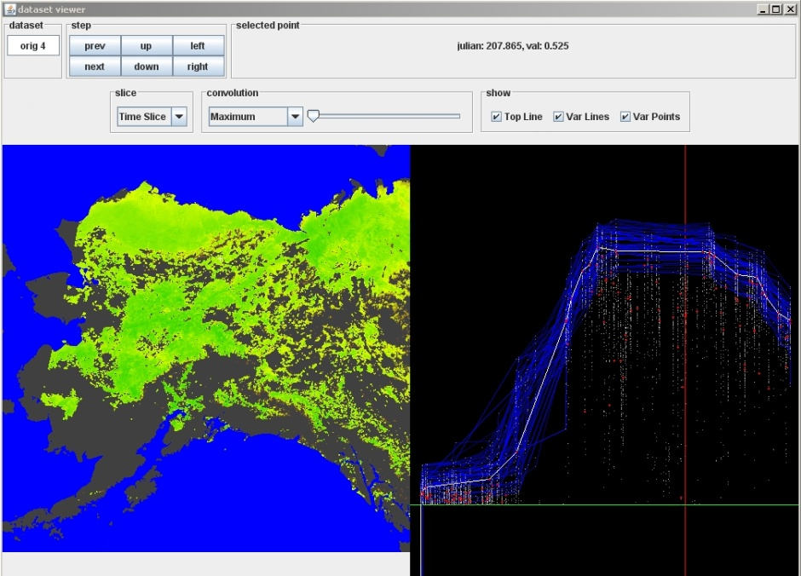
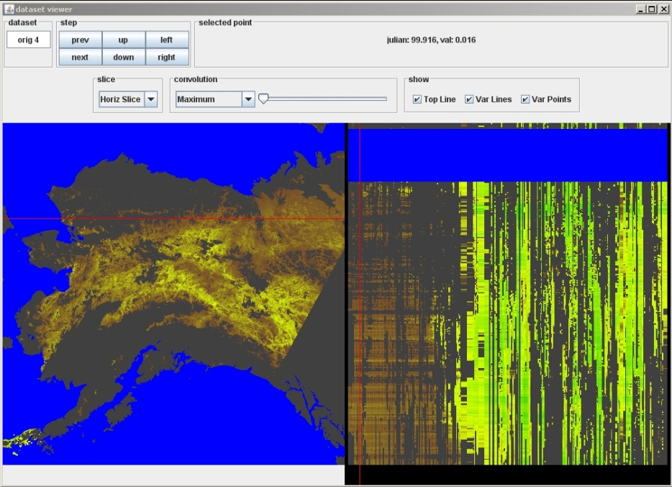
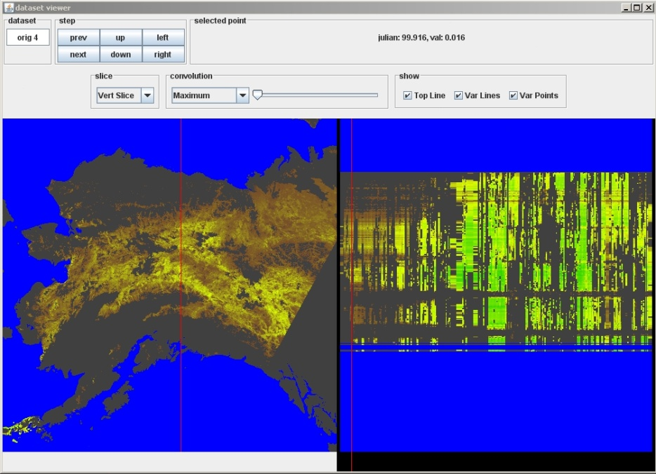
Data Stack Viewer: “On-Demand Metrics”
Time Slice
Horizontal Slice
Vertical Slice
Data Examples
Notes:
Poster created April 2010.

Slide 13
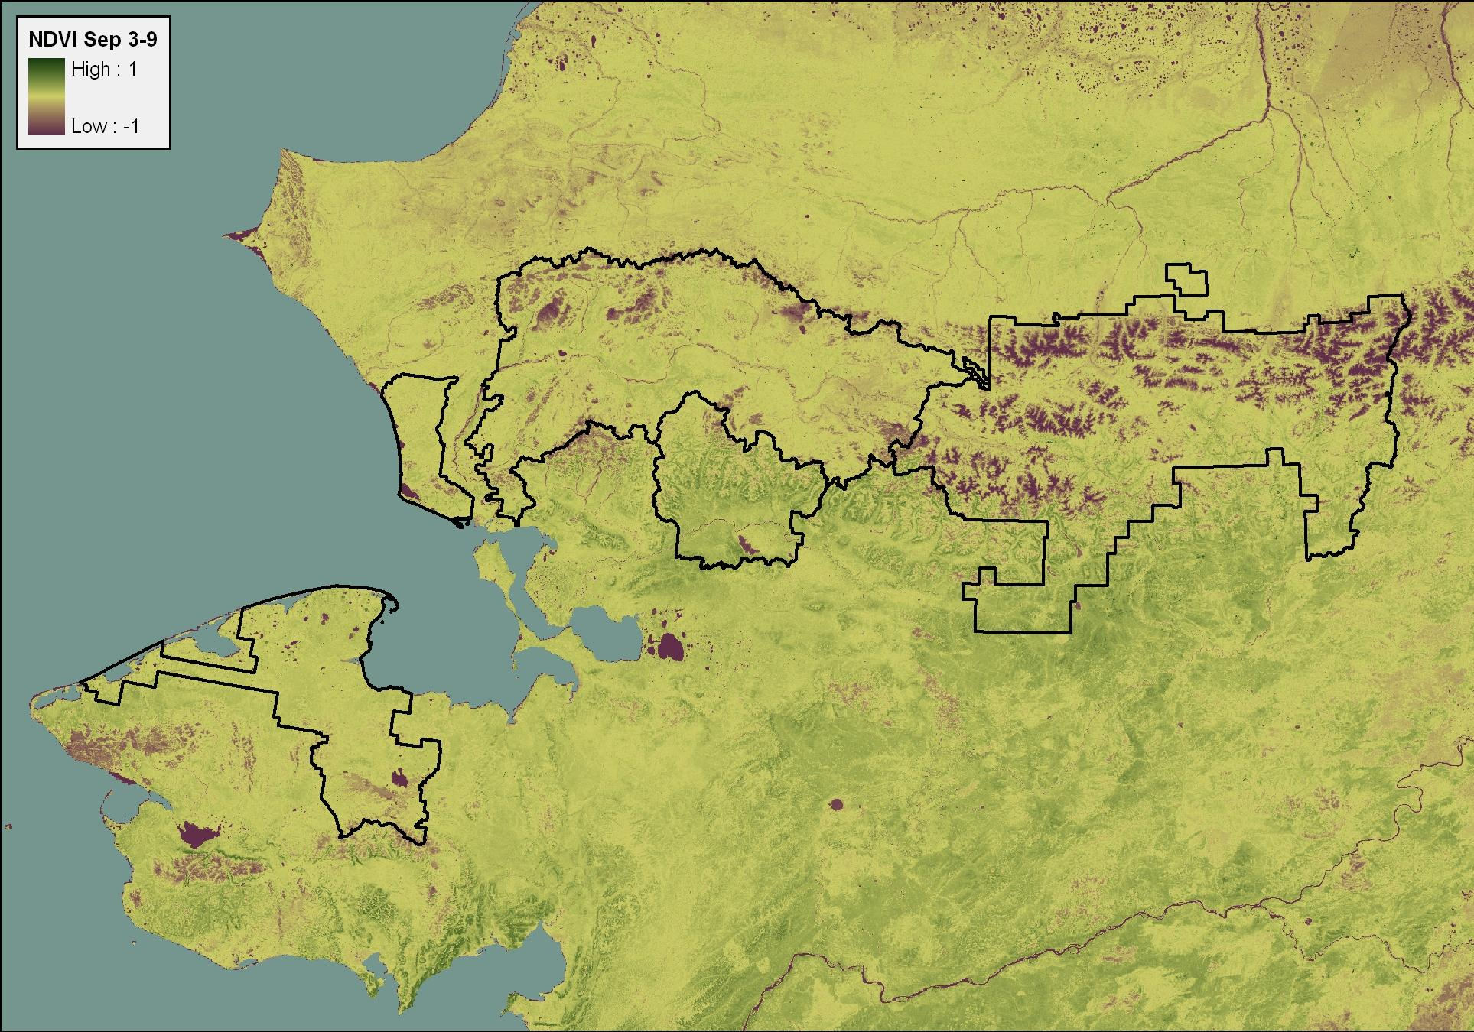
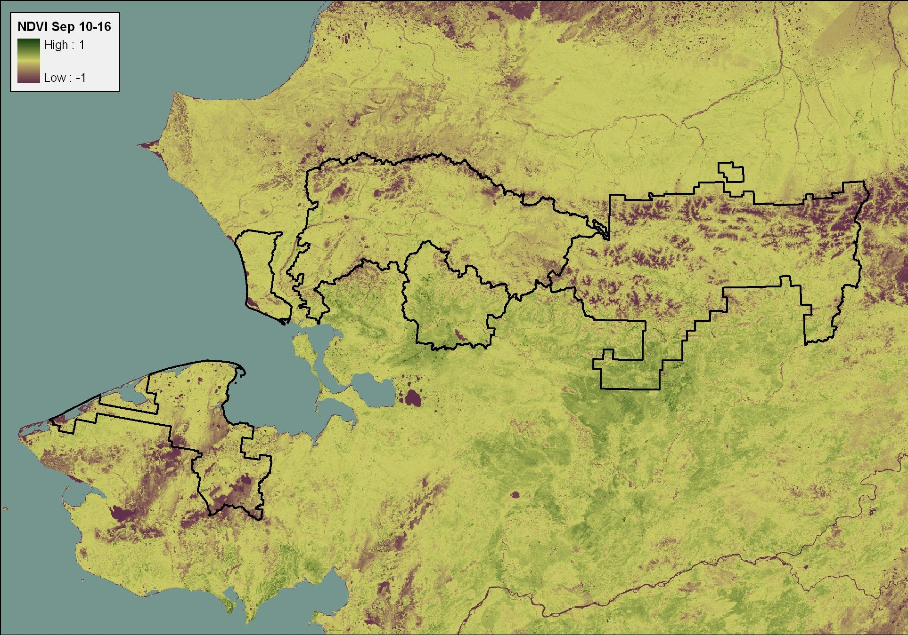
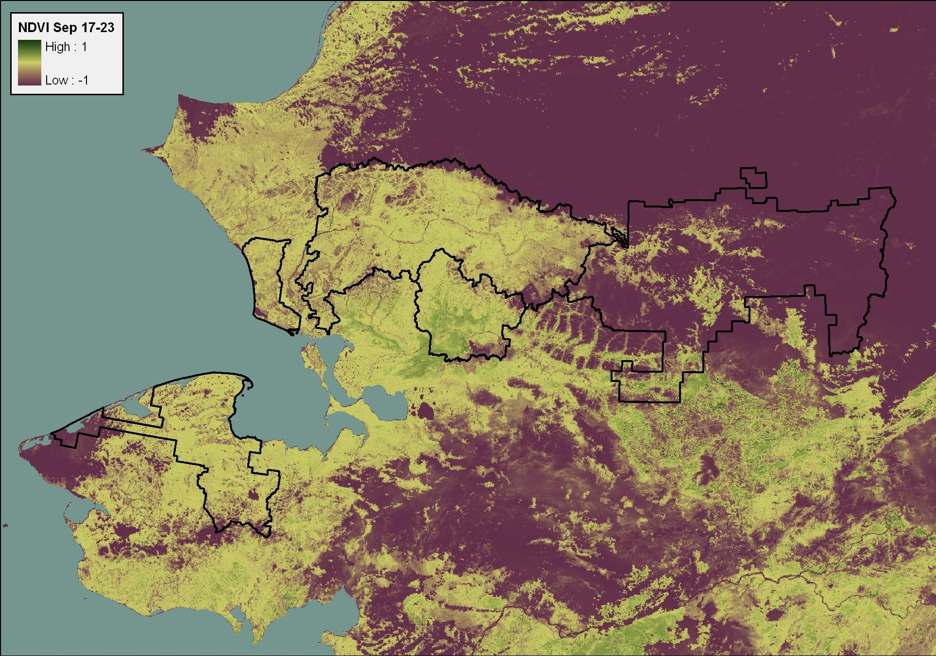
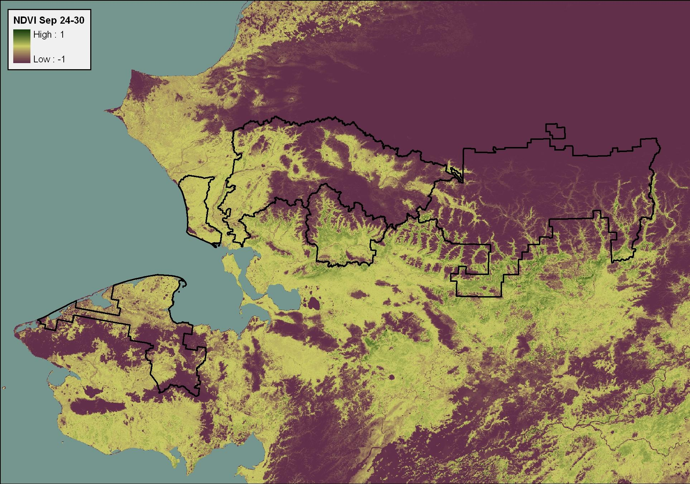
NDVI Data (September 3 – 30)
Notes:
Poster created April 2010.

Slide 14
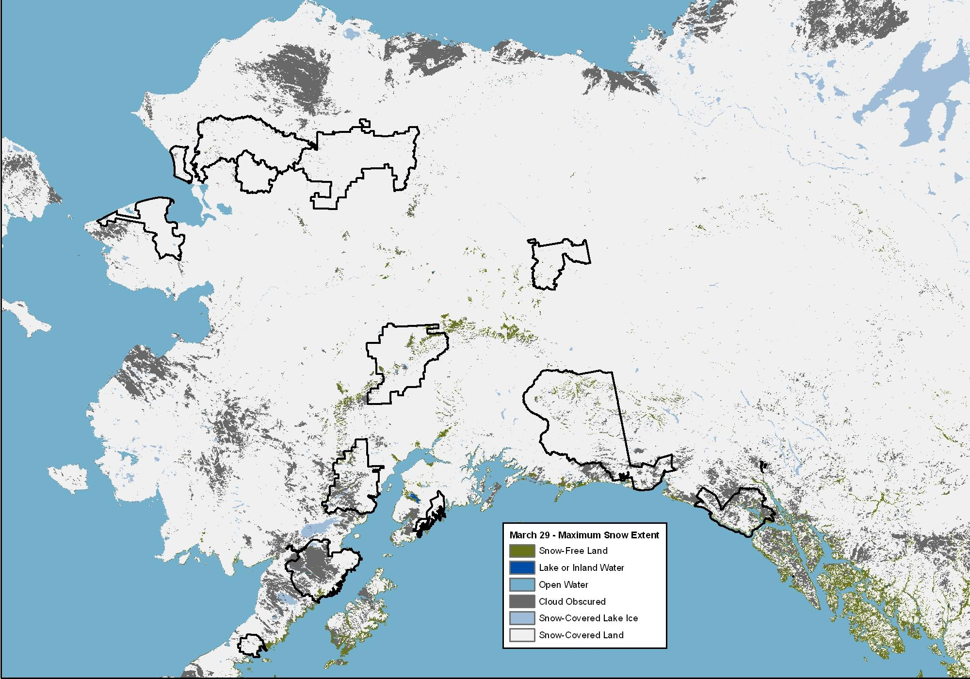
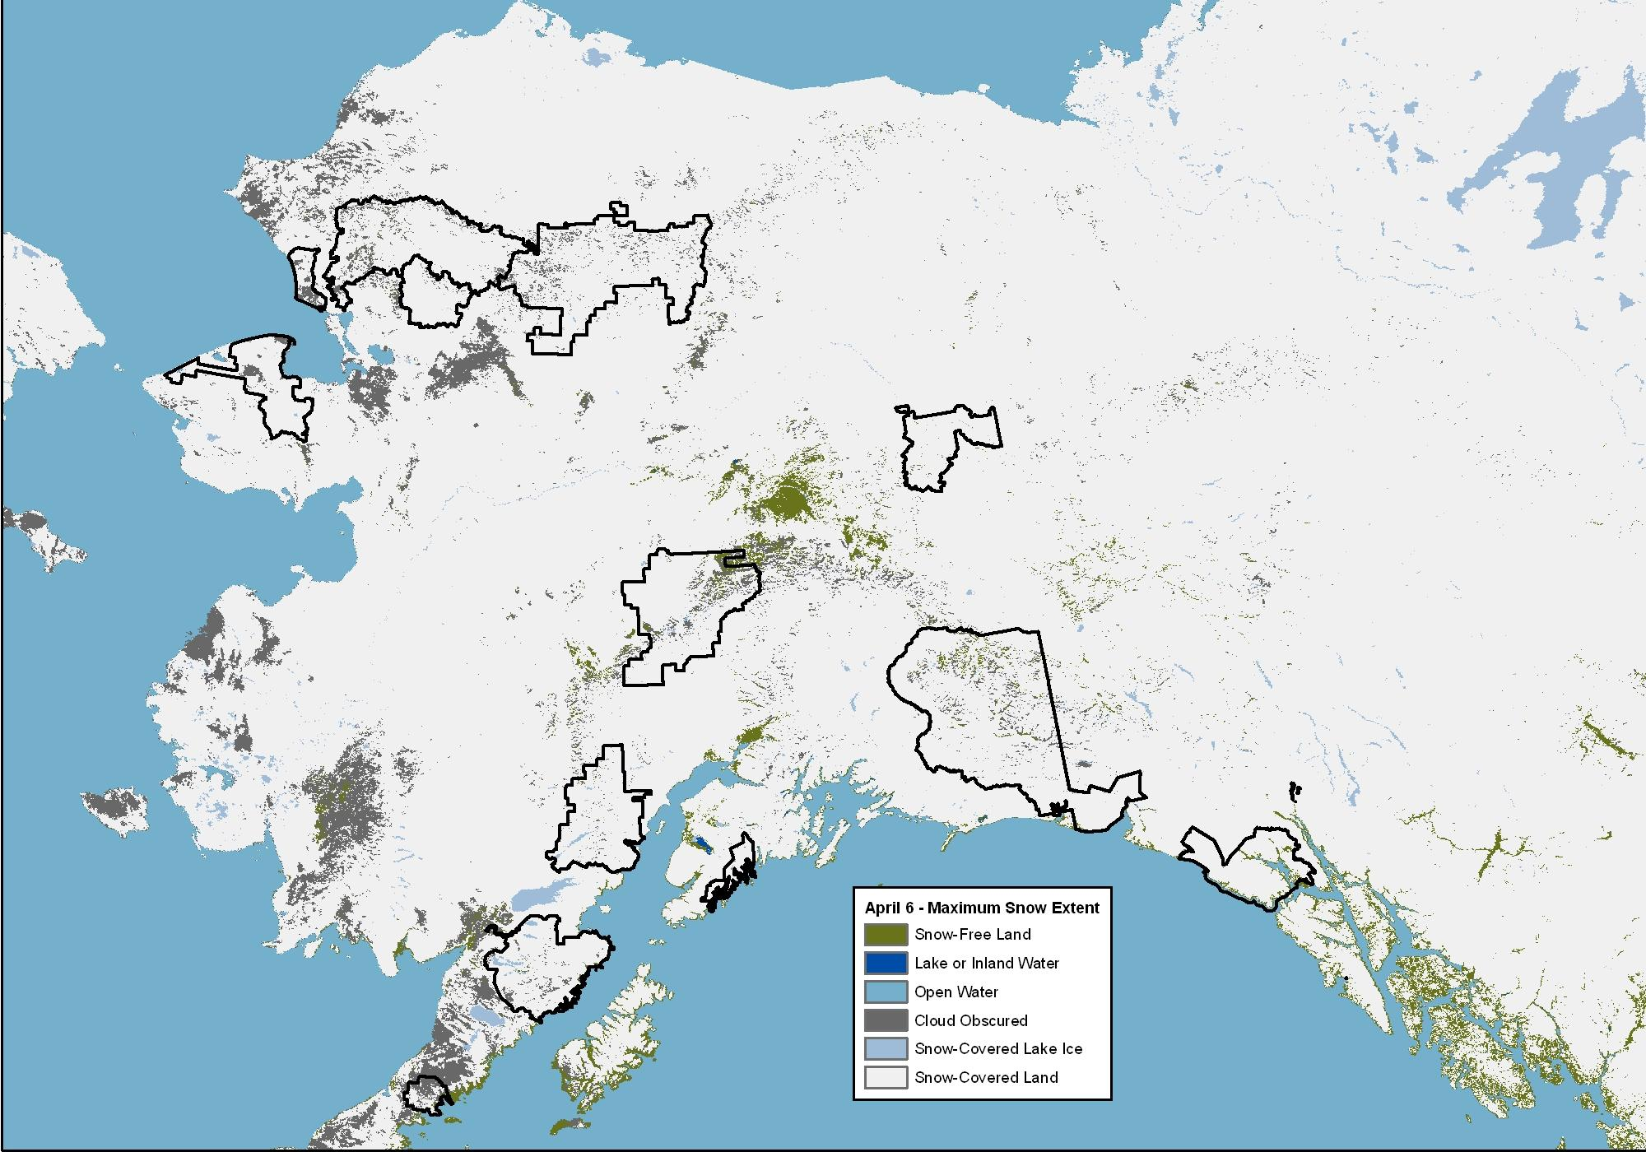
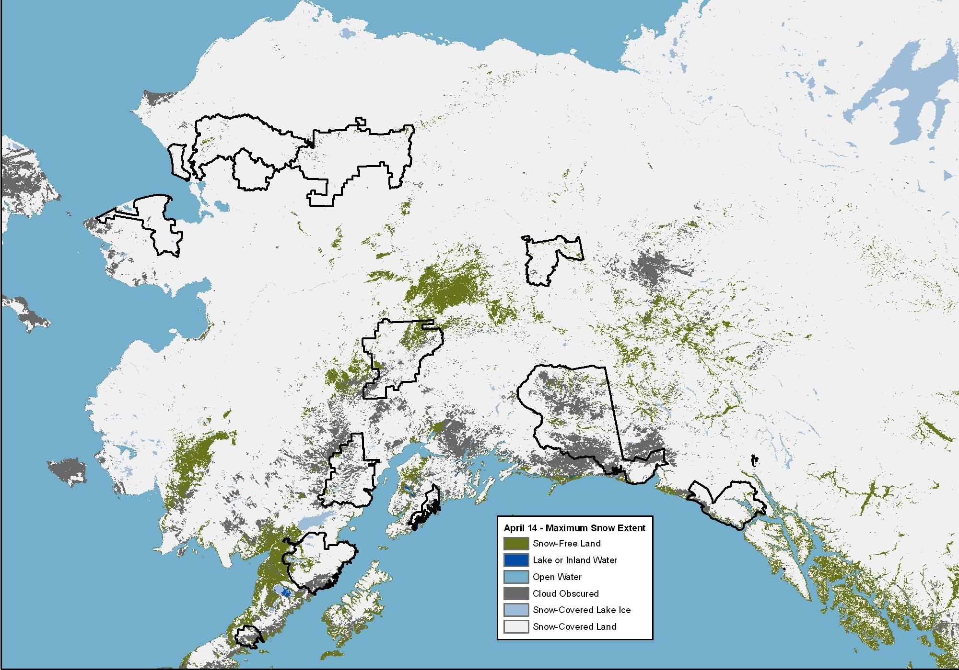
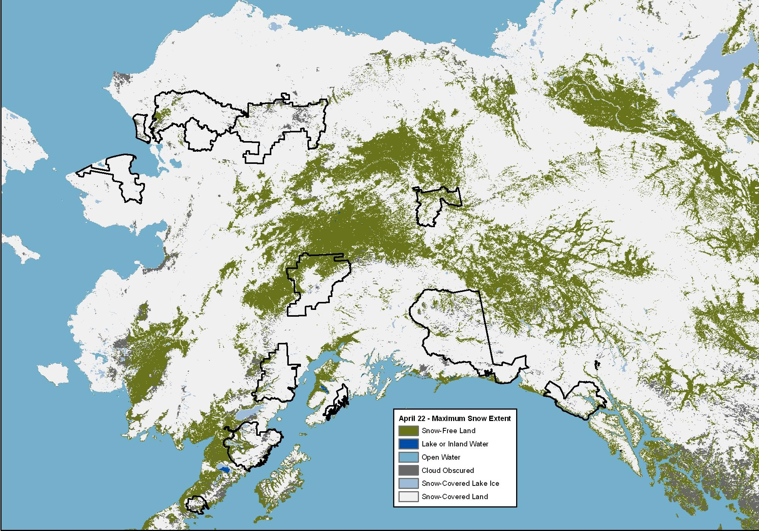
8-Day Snow Extent (March 29 – April 22)
Notes:
Poster created April 2010.

Slide 15
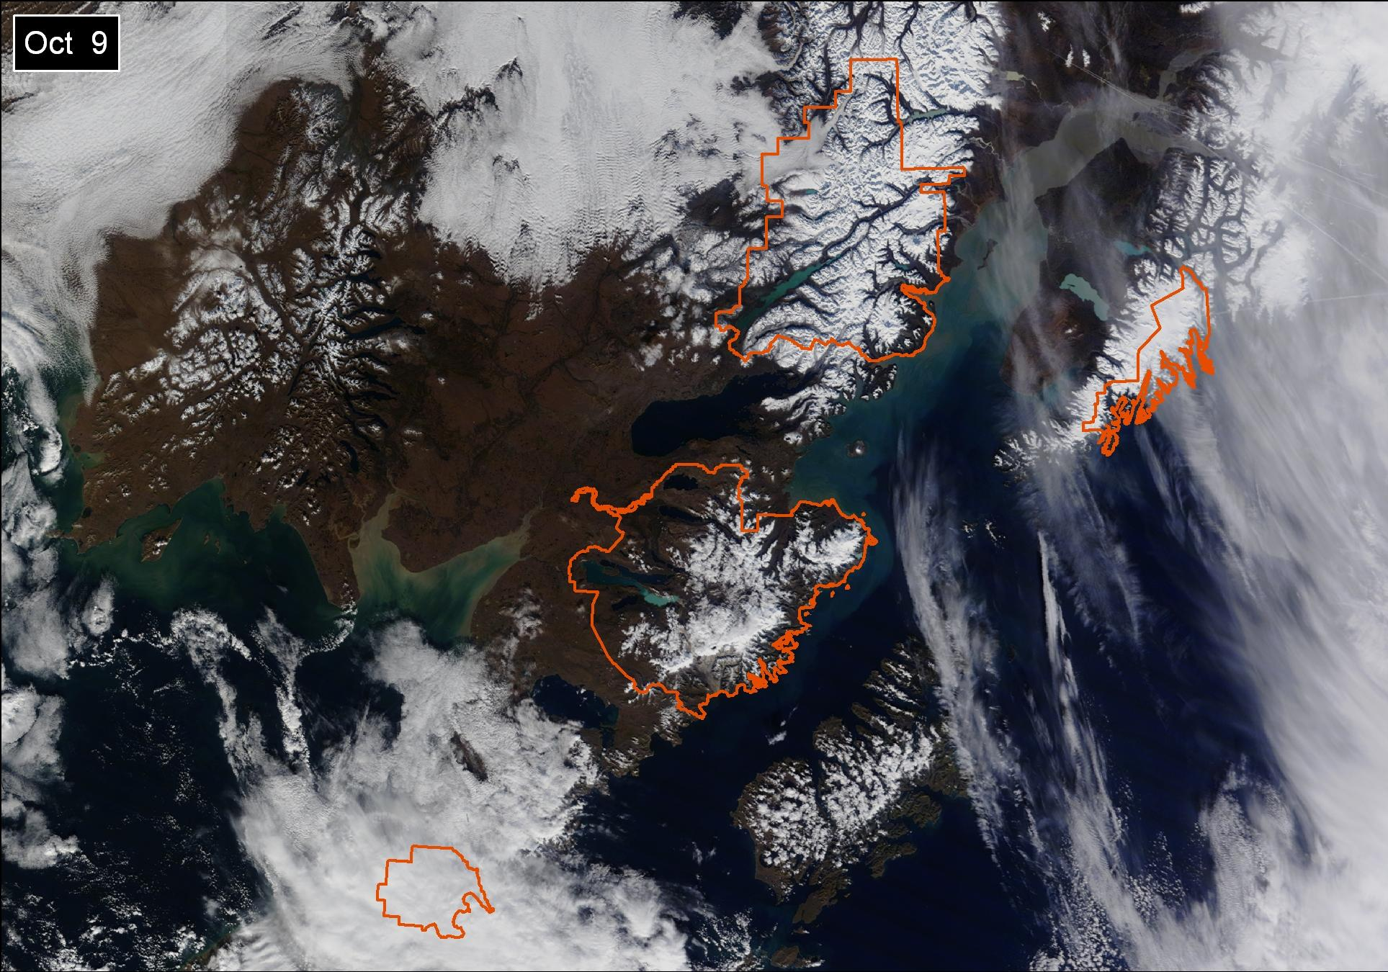
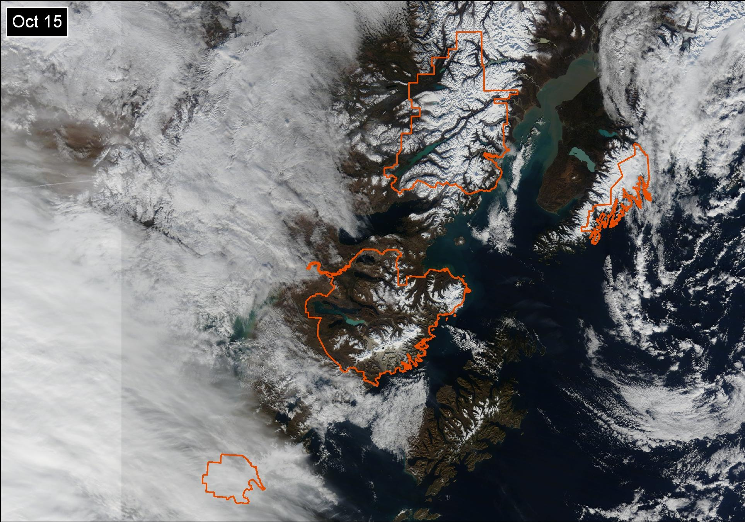
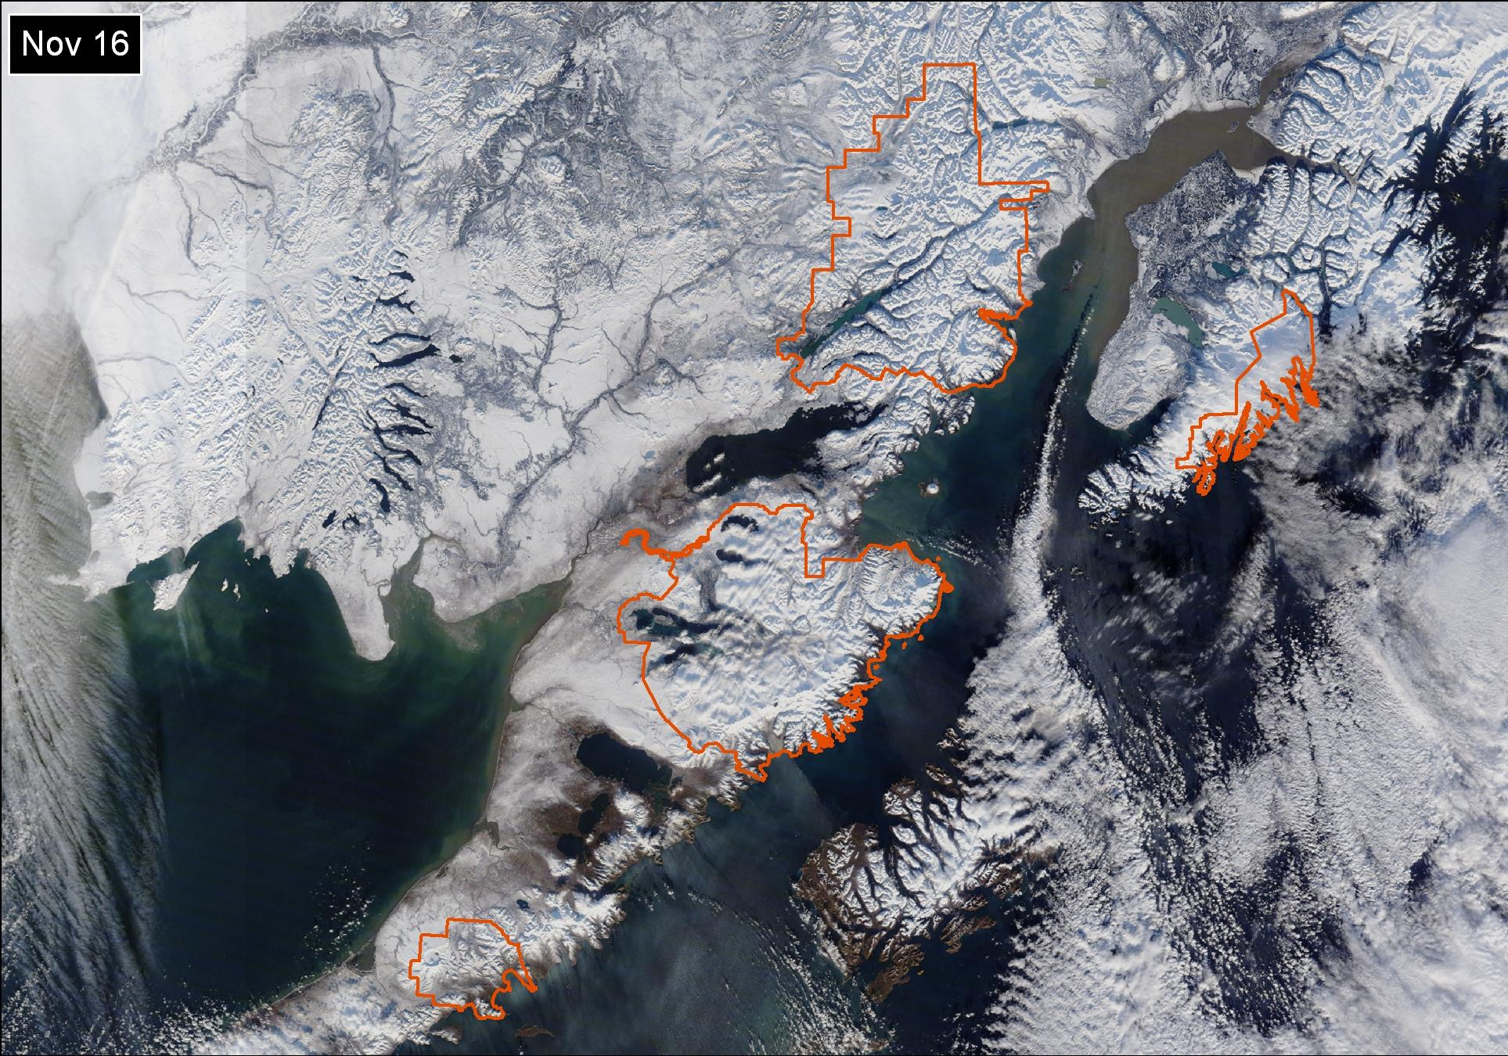
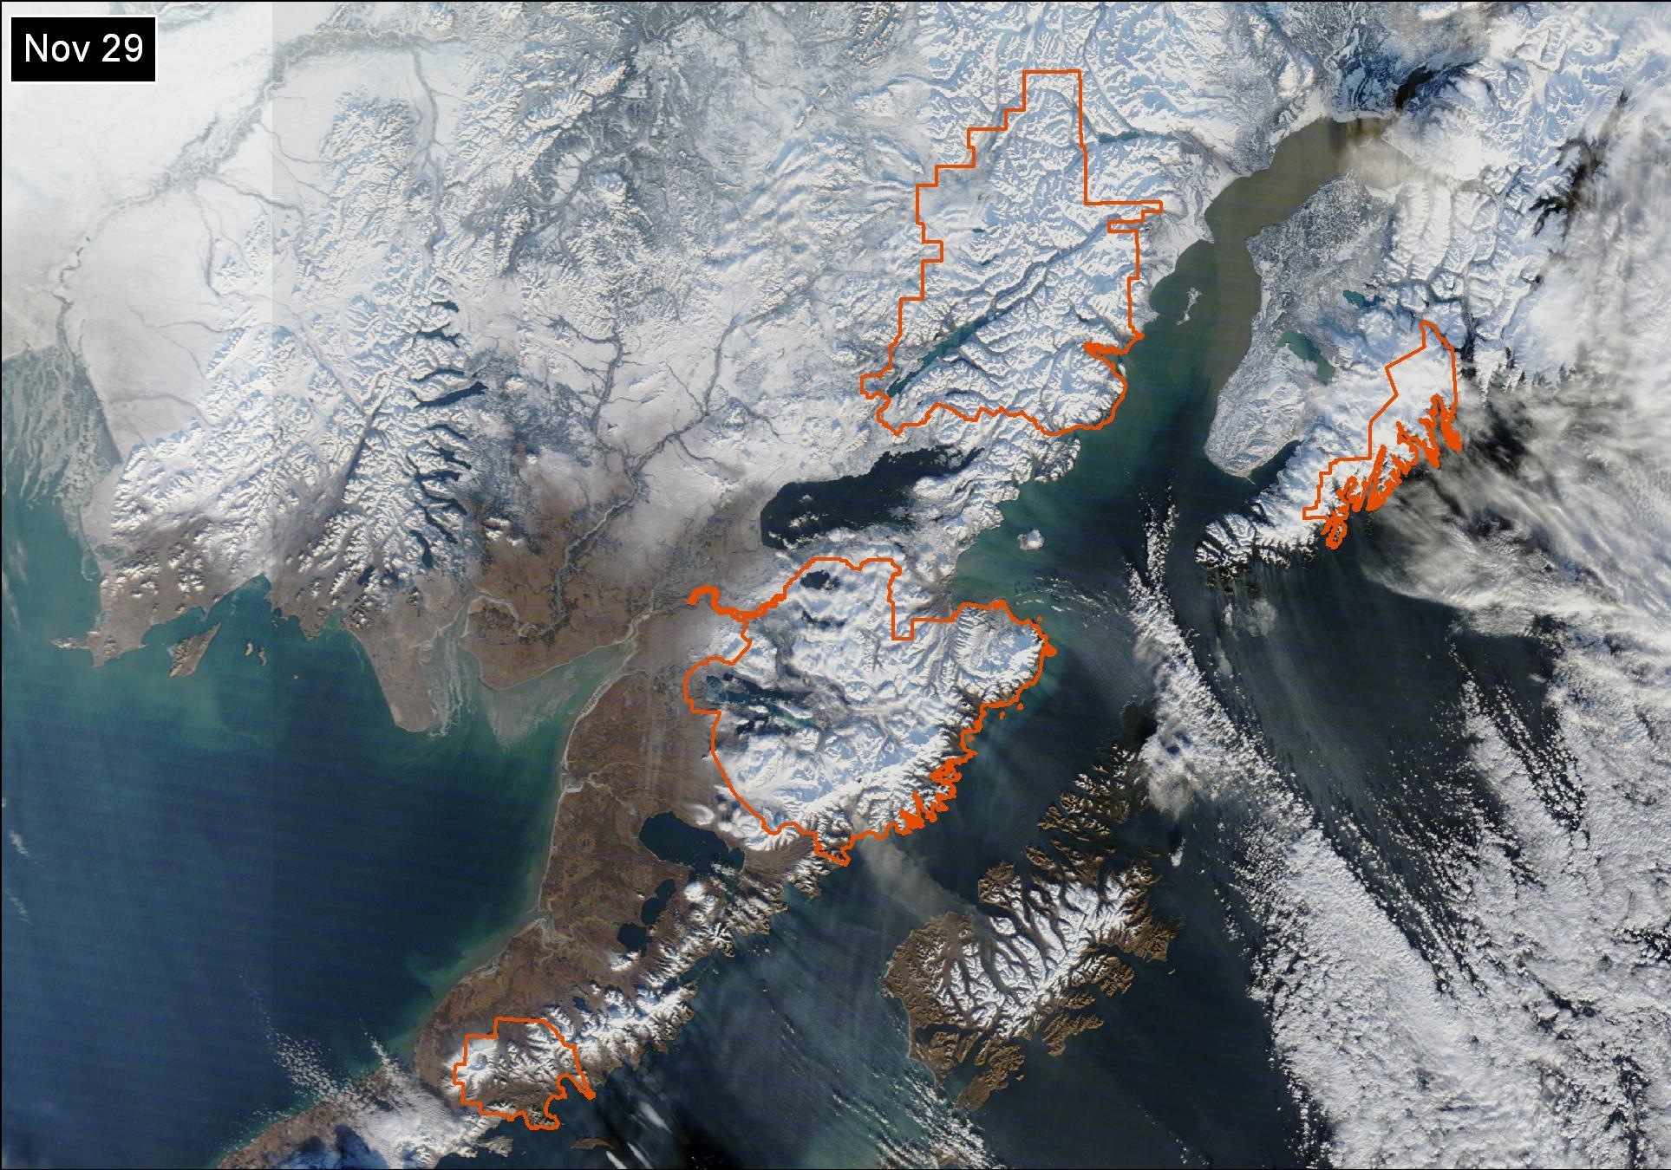
MODIS Real-Time True Color Imagery (Oct. 9 – Nov. 29)
Notes:
Poster created April 2010.

Slide 16
Project Status (Dec. 2010)
AVHRR & MODIS Real-Time True-Color Imagery available as Geotif download, WMS feed
AVHRR & MODIS NDVI available as Geotif download, WMS feed, WCS feeds – needs display tweaks.
Terra eMODIS NDVI Alaska Mosaics weekly from 2000 through 2009 and continuing
250m, 500m, 1000m resolutions
Includes Cloud, Water, Snow, Date of Acquisition mask
Imagery mapped to an Alaska Albers projection
eMODIS map extent needs to be larger to include all park units
AVHRR NDVI Alaska Mosaics bi-weekly from 1990 through 2009 (April – October)
1000m resolution
Cloud, Date of Acquisition mask
Imagery mapped to an Alaska Albers projection
Layer files (symbology) need to be developed for easier display in ArcMap
Review of 8-day / daily snow products by NPS is needed before snow archive can be built
Metrics need to be generated for NDVI and Snow archives
Data stack and curves for 7-day NDVI composites:
Start of season (Julian date)
End of growing season (Julian date)
Maximum NDVI
Area under curve
Growing season should run from Jan 1 – Dec 31
Data stack and curves for SNOW composites
Start of season = 1st snow (snow on)
End of snow season = last snow (snow off)
Number of days snow on
Variability metric (TBD)
Water year should run from Oct 1 – Sep 30
Two metrics deliveries per year
NPS will get two product deliveries per year – one NDVI, and one Snow .
Deliveries to be at end of NDVI season, and end of Snow Season
Notes:
Poster created April 2010.

Slide 17
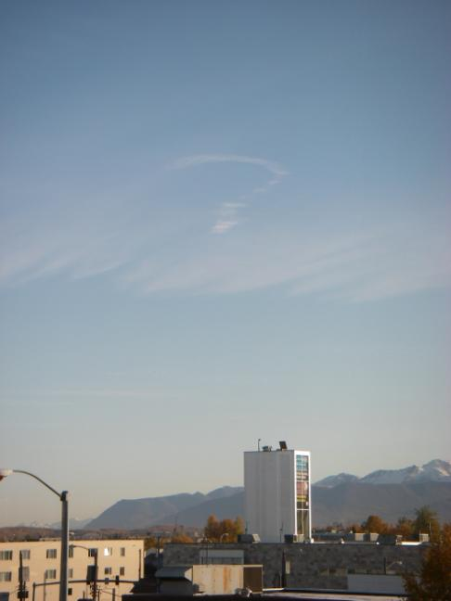
Questions?
Notes:
Poster created April 2010.

